Slide 1
How do we change the Constitution?
Steps:
1.
2.
3.
4.
5.
6.

Slide 2

Definition
A referendum is a vote of the Australian electors on a proposed change to the Constitution.

Slide 3
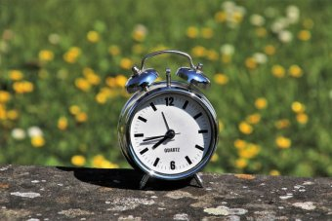
Western Australian daylight saving referendum, 2009
The 2009 Western Australian daylight savings referendum was held on 16 May 2009 in the Australian state of Western Australia to decide if daylight saving time should be adopted. It was the fourth such proposal which had been put to Western Australian voters and followed a three-year trial period.

Slide 4

Are you in favour of daylight saving being introduced in Western Australia by standard time in the State being advanced one hour from the last Sunday in October 2009 until the last Sunday in March 2010 and in similar fashion for each following year?

Slide 5

Referendum worksheet!
Complete the worksheet or it is homework!

Slide 6



State and federal roles
The Australian Constitution lists those areas of government that come under federal and state responsibilities.
That means that the federal government and state governments have different roles.

Slide 7
Draw this table in your notes.
FEDERAL | STATE

Slide 8

Guessing game!
Cut out the responsibilities given to you by your teacher.
Place them in the columns you think they go under.

Slide 9
FEDERAL | STATE
Foreign policy | Schools
Currency | Hospitals
Immigration | Roads and railways
Defence | Police
Weights and measures | Mining and agriculture
Social security | Prisons
Trade and commerce | Public transport
Postal and communication services | Utilities such as electricity and water

